Slide 1
Developing telegram bot “Digital Wellbeing”
@DQL_2022_bot
Natallia Kostsina

Slide 2
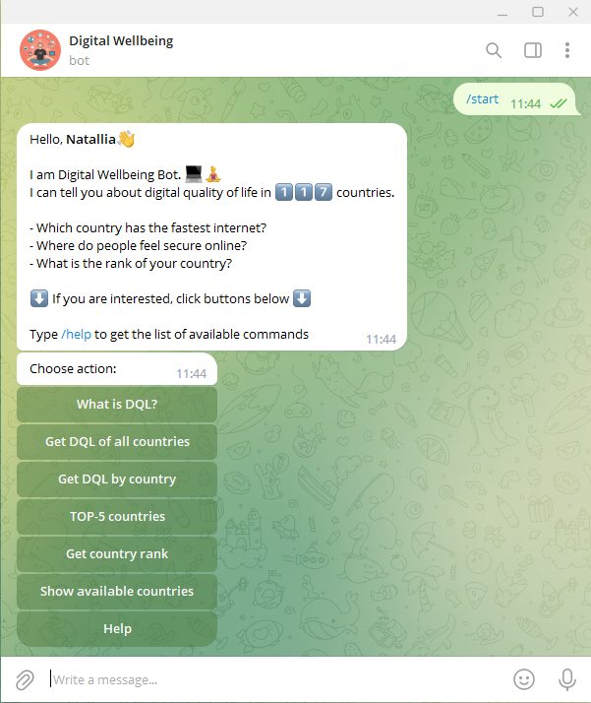
Technical requirements
1. Install Telegram (supported OS: iOS (9.0 and above), Android (6.0 and up), Windows, macOS, Linux )
OR
Use web application: Web Telegram
Type @DQL_2022_bot in
search field OR follow the link https://t.me/DQL_2022_bot
Click Start or type /start
Choose action from the list

Slide 3
Time to /start

Slide 4

purpose
More general motivation: create useful software that will provide a user valuable information about digital quality of life in different countries with data visualization
More specific purpose: help users to choose the country that is more preferable to live and work based on its digital level

Slide 5
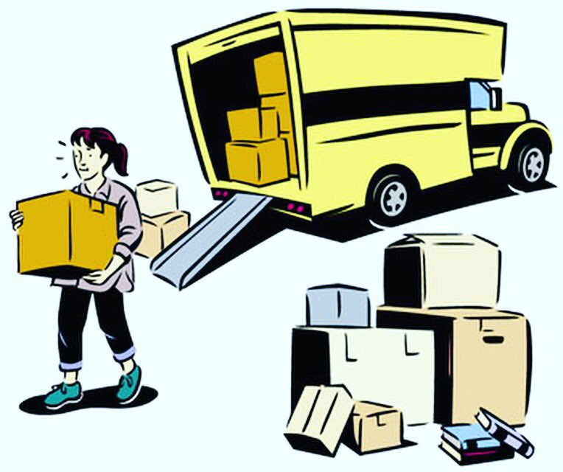






Why you should use “Digital Wellbeing” ?
OR
Digital Wellbeing

Slide 6



Developing process
2 main tasks:
Represent data in an understandable way
Give the user the possibility to extract some pieces of data

Slide 7
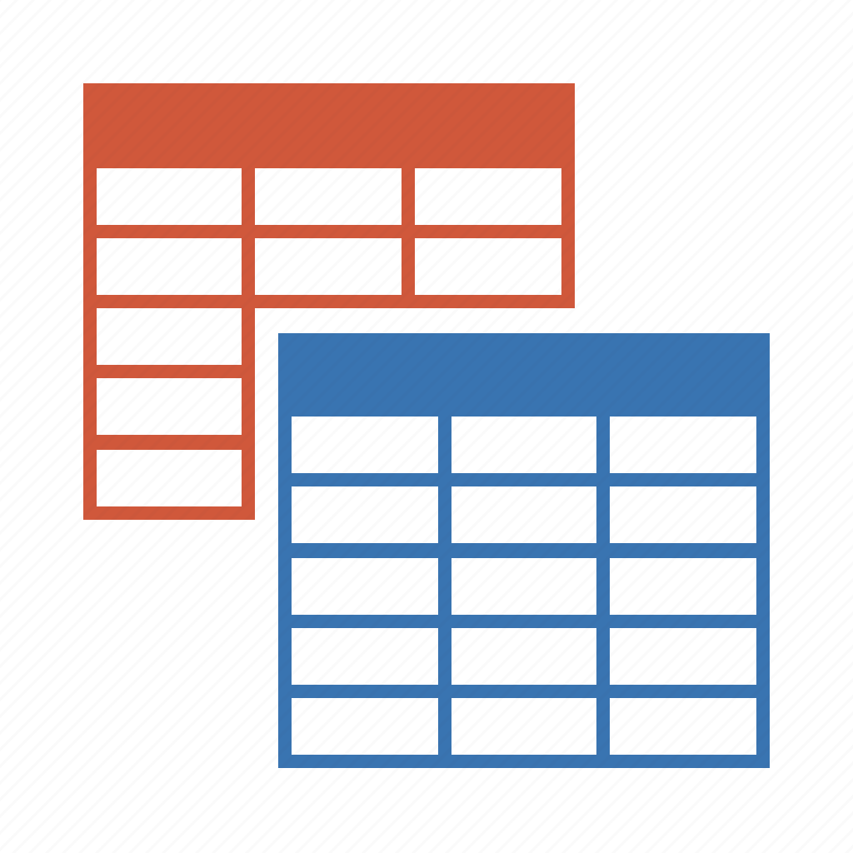

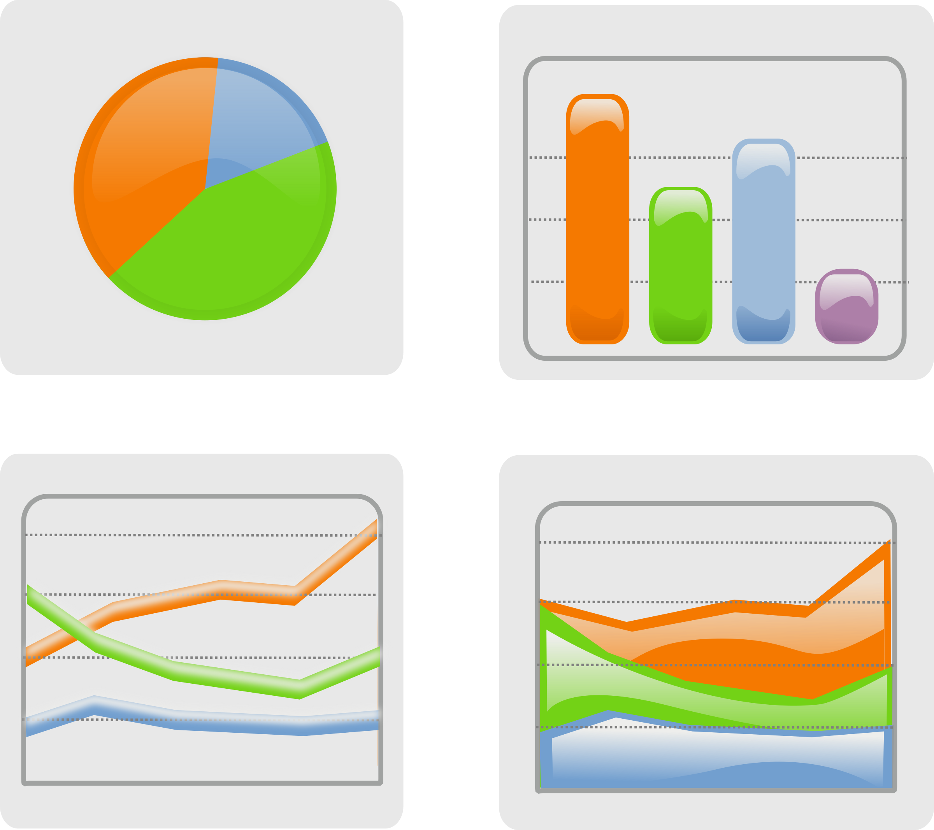

Possible approaches to solve problem
How to represent data?
Tables
Inline text
Charts
Separate text file

Slide 8
Possible approaches to solve problem
How to represent data?
Tables
Inline text
Charts
Separate text file

Slide 9
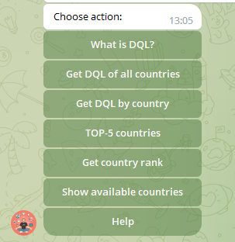


Possible approaches to solve problem
How the user can interact with data?
Type actions
Choose from the list
Voice recognition

Slide 10
Possible approaches to solve problem
How the user can interact with data?
Typing actions
Choose from the list
Voice recognition

Slide 11
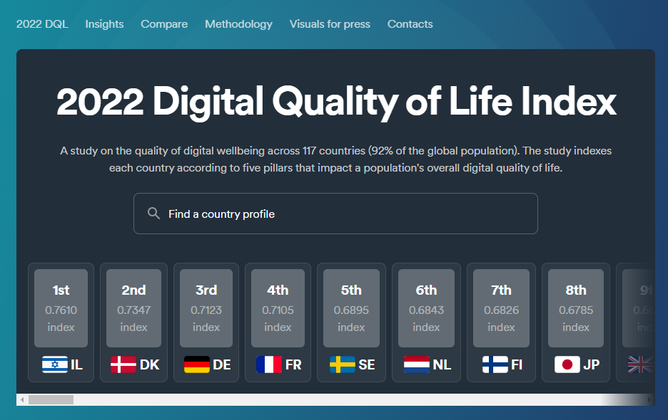
Possible approaches to solve problem
Examples of other solutions
https://surfshark.com/dql2022
Data representation: text
Interaction: possibility to type country

Slide 12
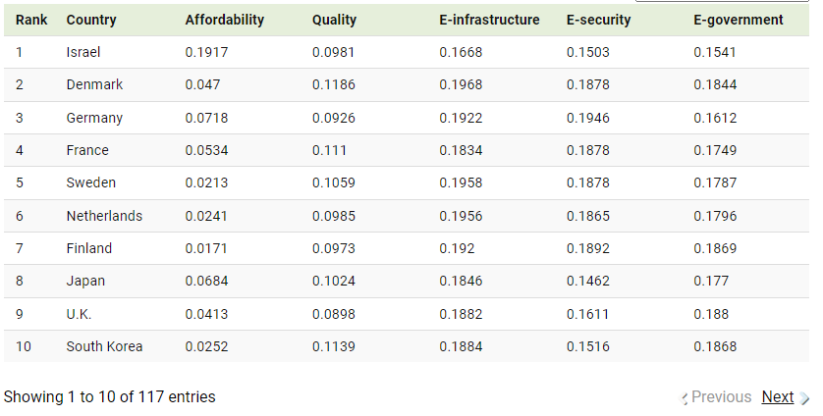
Possible approaches to solve problem
Examples of other solutions
https://www.visualcapitalist.com/cp/ranking-countries-by-digital-quality-of-life-2022/
Data representation: table
Interaction: no

Slide 13
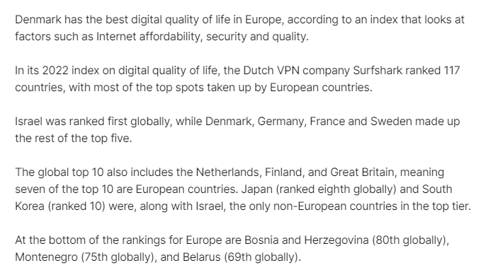
Possible approaches to solve problem
Examples of other solutions
https://www.euronews.com/next/2022/09/21/which-european-country-has-the-best-digital-quality-of-life
Data representation: text
Interaction: no

Slide 14
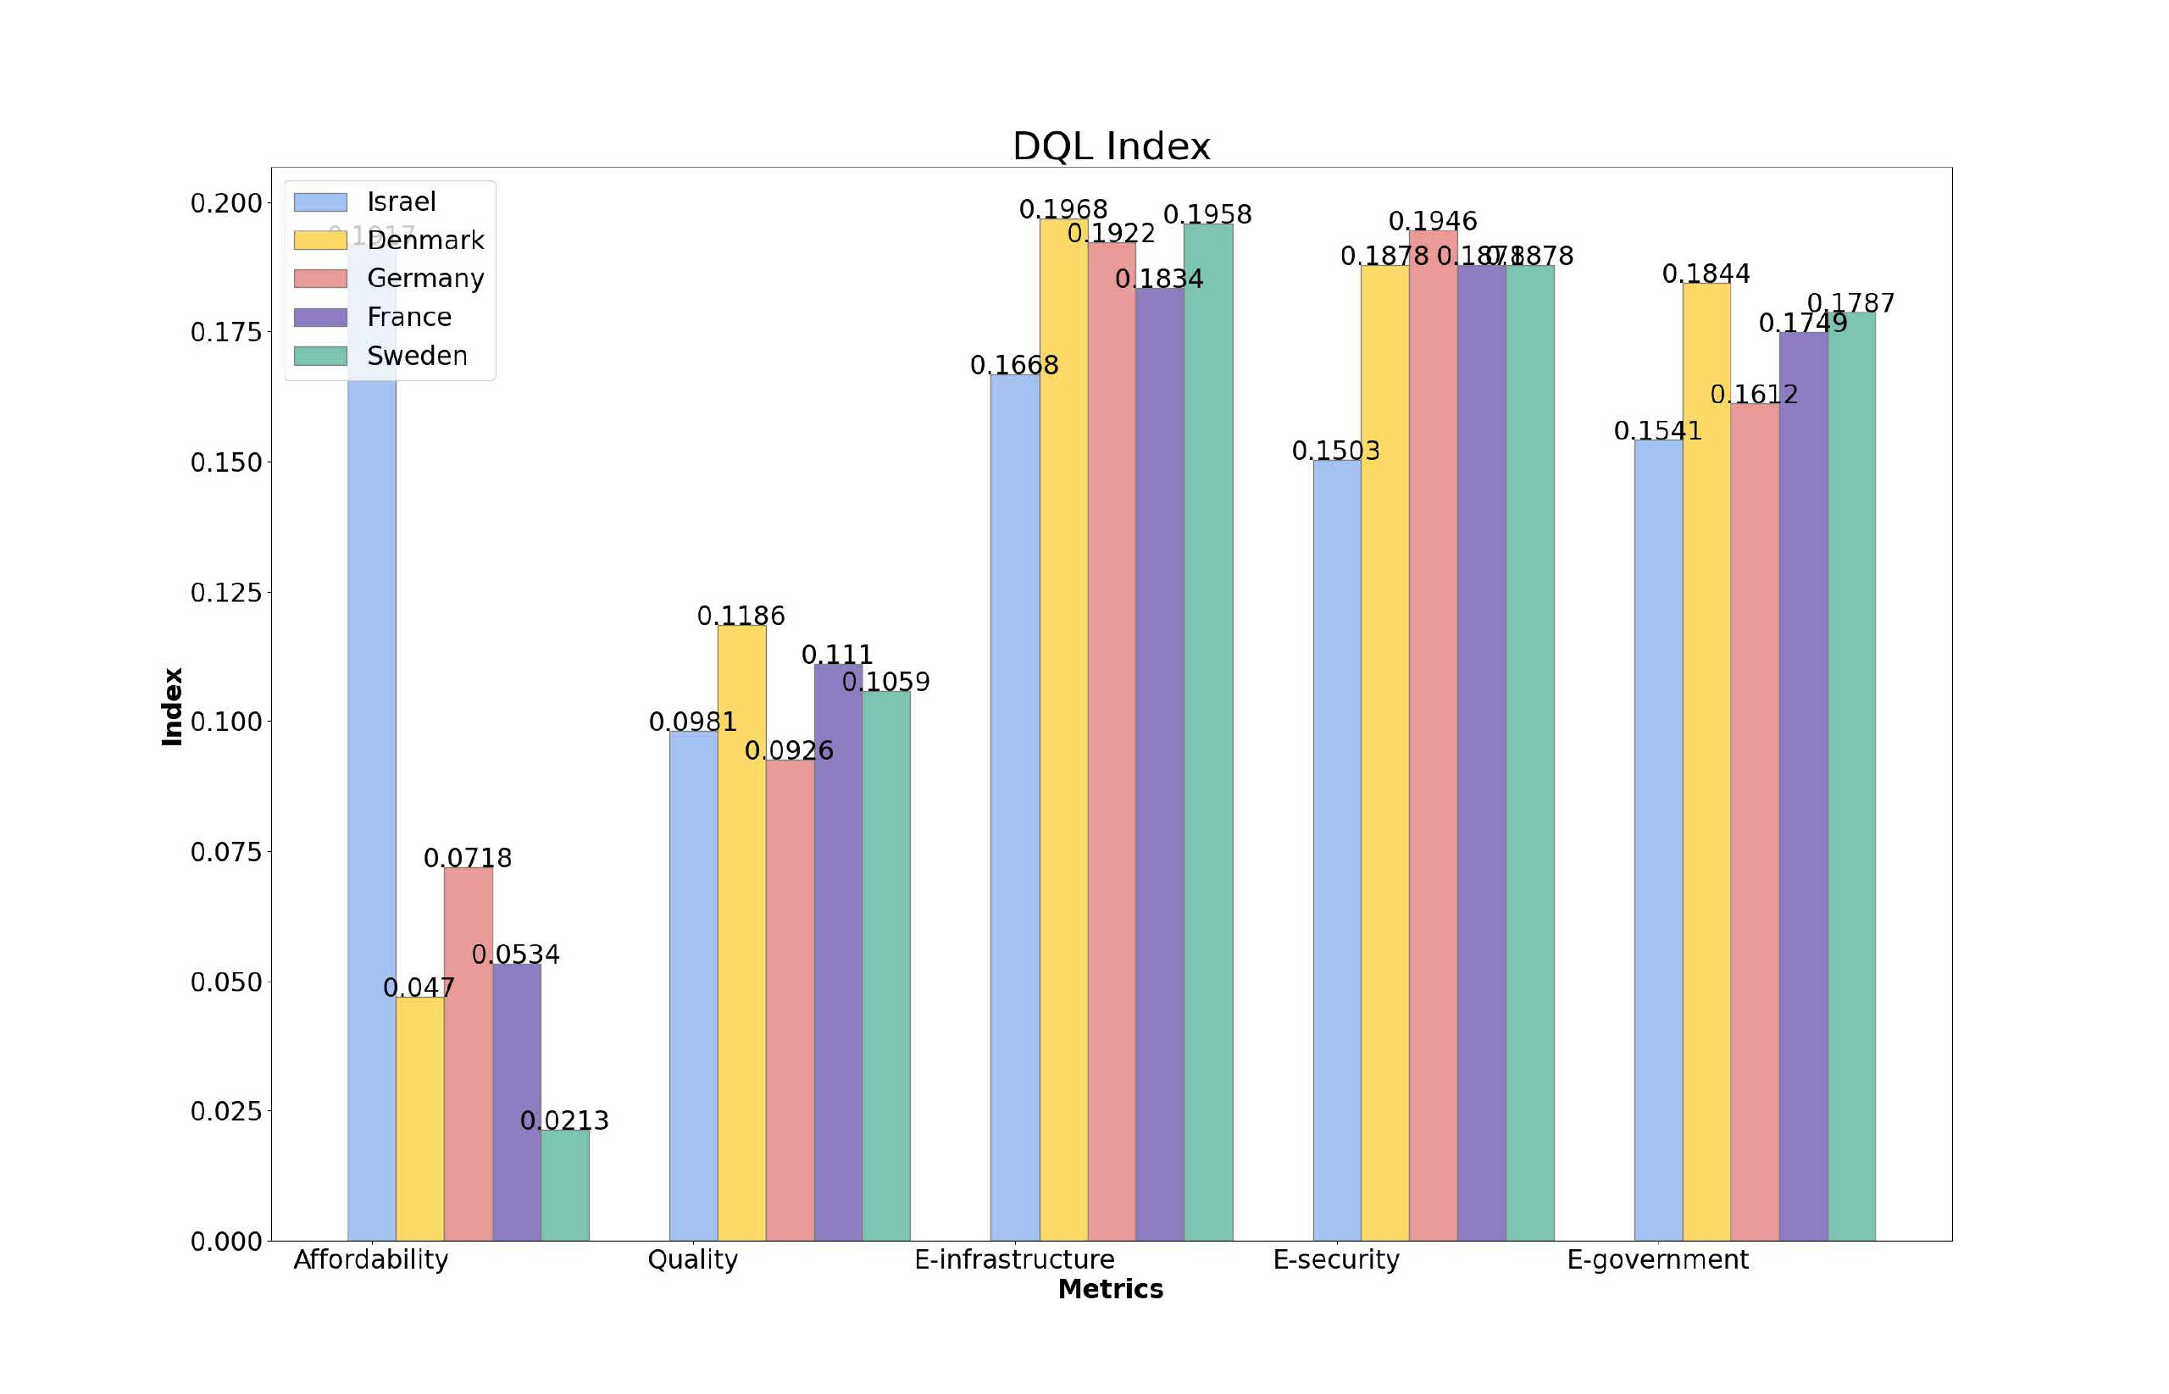
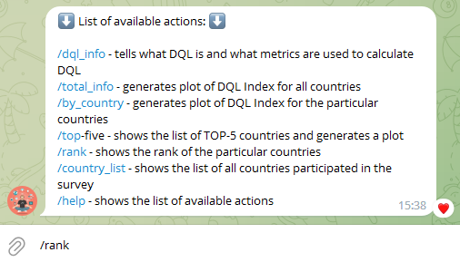
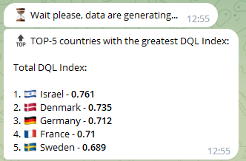
Possible approaches to solve problem
Selected approach
2. Interaction:
Data representation:
List of possible actions
Bar charts
Inline text
Typing

Slide 15


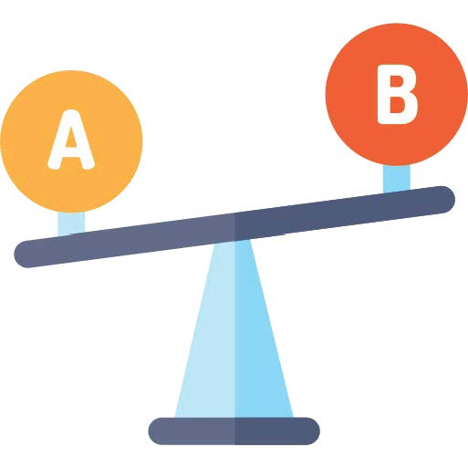


Major Features
DQL of all countries
DQL of selected countries
TOP-5 countries
country rank
About survey
Get info in the form of bar charts
Sort results:
- by rank
- by country in alphabetical order
Get detailed info about a country
Compare countries according to their DQL Indexes
Get detailed info about top-5 countries
Type country name and see which rank it has
Read about the survey and the metrics used to calculate DQL Index

Slide 16
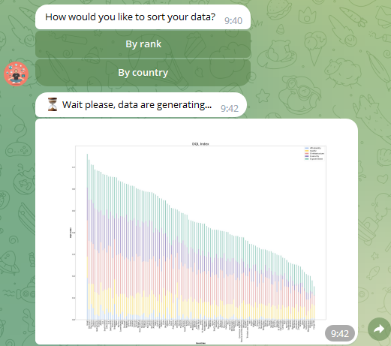
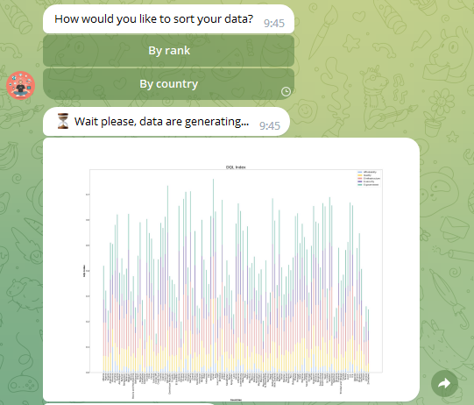
DQL of all countries
Sort by rank
Sort by country

Slide 17
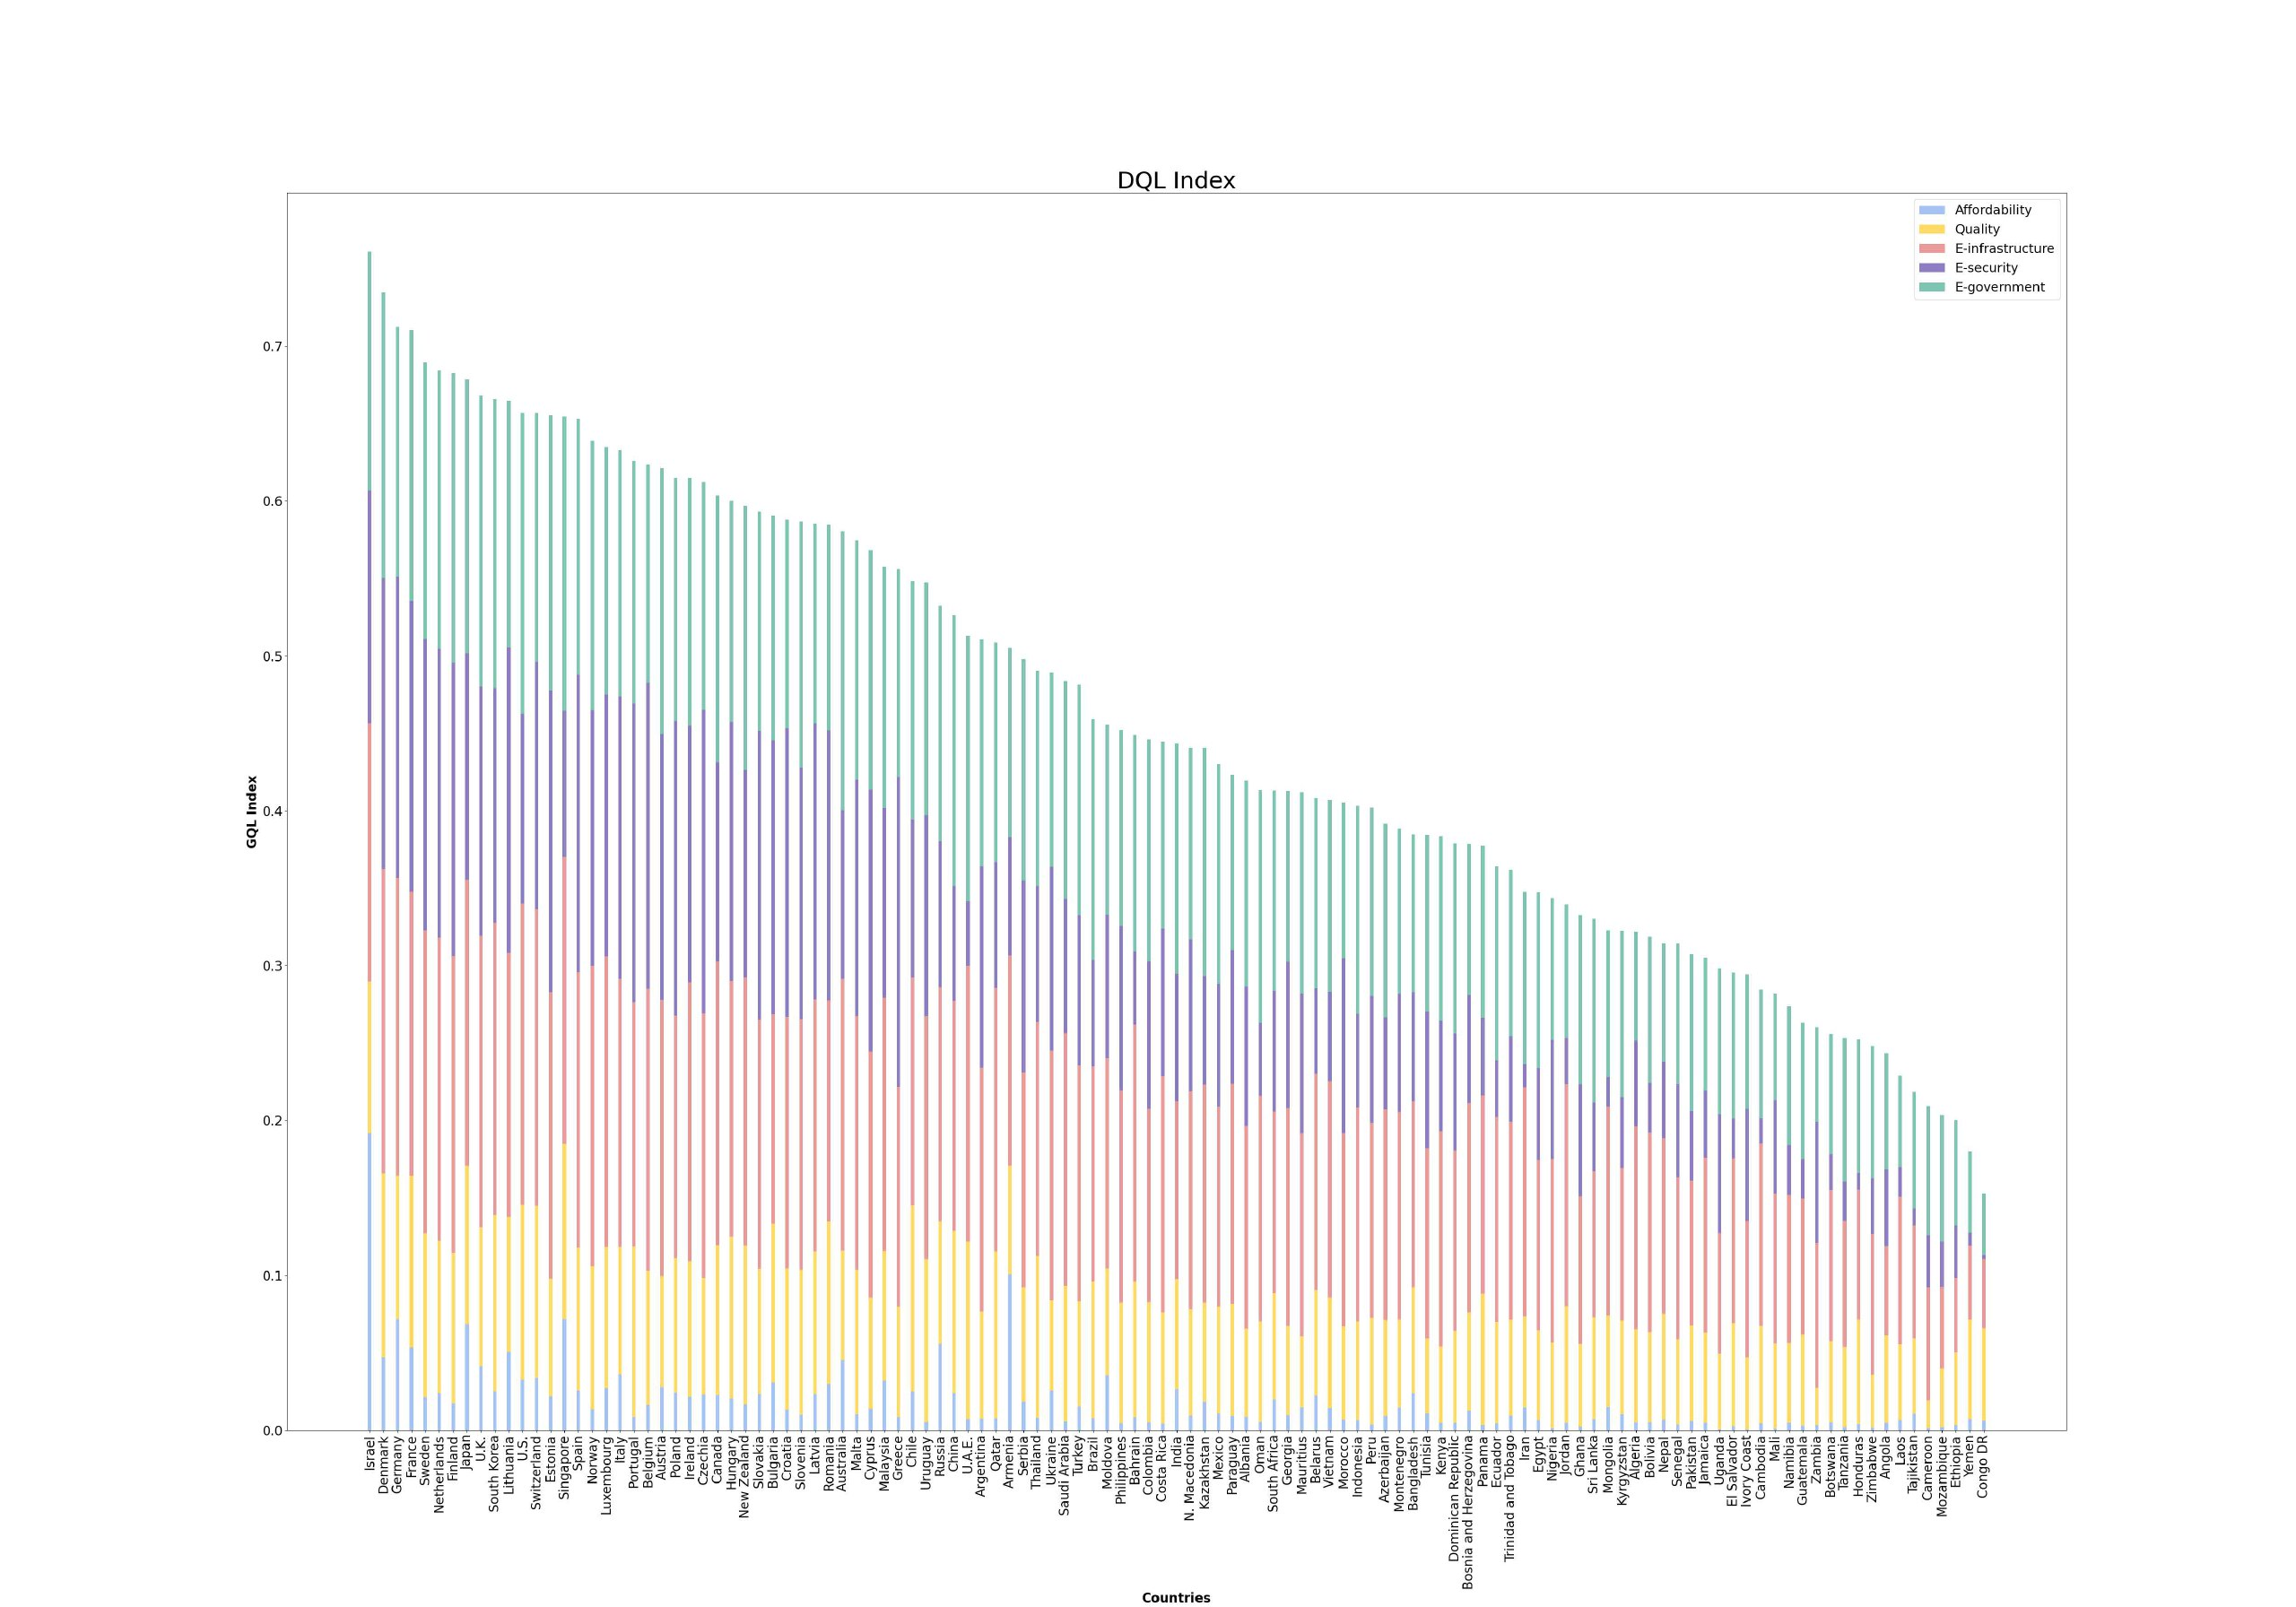
DQL of all countries

Slide 18
Major Features
DQL of all countries
DQL of selected countries
TOP-5 countries
country rank
About survey
Get info in the form of bar charts
Sort results:
- by rank
- by country in alphabetical order
Get detailed info about a country
Compare countries according to their DQL Indexes
Get detailed info about top-5 countries
Type country name and see which rank it has
Read about the survey and the metrics used to calculate DQL Index

Slide 19
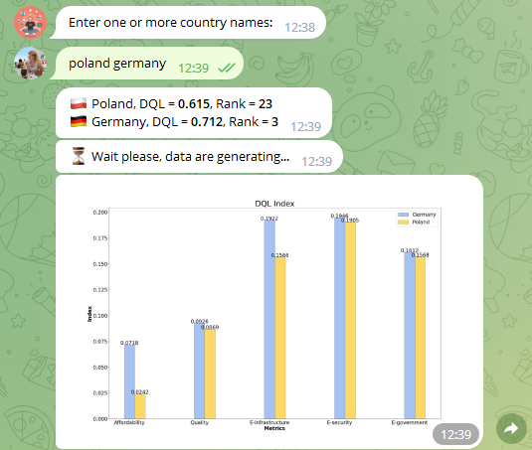
DQL of selected countries

Slide 20
Major Features
DQL of all countries
DQL of selected countries
TOP-5 countries
country rank
About survey
Get info in the form of bar charts
Sort results:
- by rank
- by country in alphabetical order
Get detailed info about a country
Compare countries according to their DQL Indexes
Get detailed info about top-5 countries
Type country name and see which rank it has
Read about the survey and the metrics used to calculate DQL Index

Slide 21
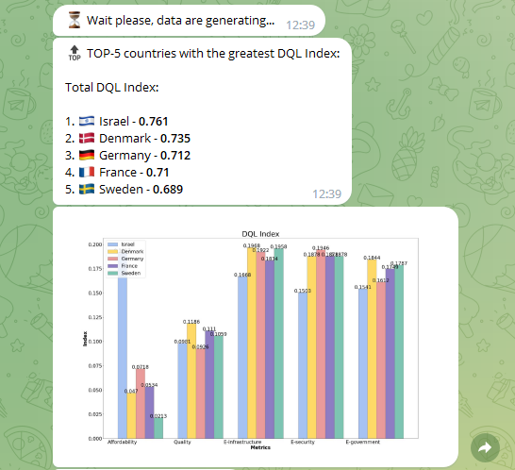
Top-5 countries

Slide 22
Top-5 countries

Slide 23
Major Features
DQL of all countries
DQL of selected countries
TOP-5 countries
country rank
About survey
Get info in the form of bar charts
Sort results:
- by rank
- by country in alphabetical order
Get detailed info about a country
Compare countries according to their DQL Indexes
Get detailed info about top-5 countries
Type country name and see which rank it has
Read about the survey and the metrics used to calculate DQL Index

Slide 24
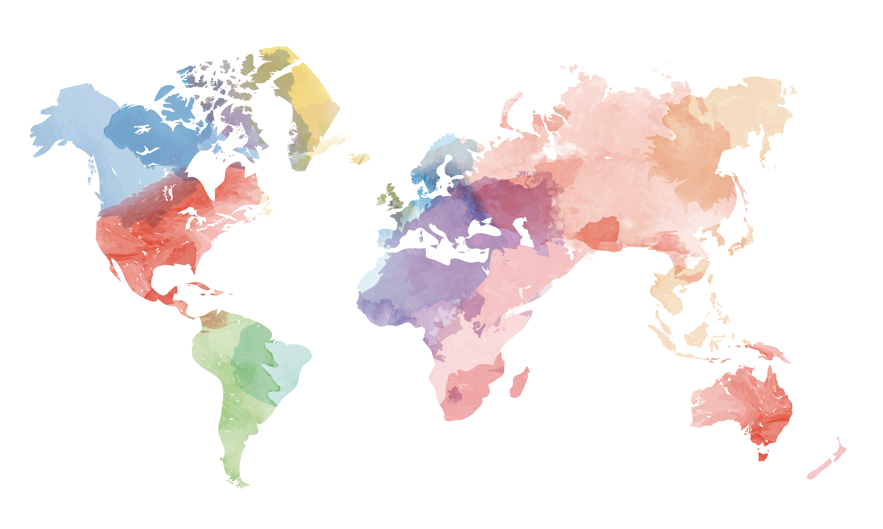
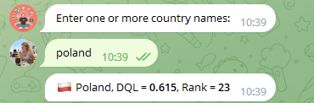


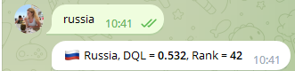
Country rank
Poland: #26
Russia: #26
Japan: #8
Australia: #35

Slide 25
Major Features
DQL of all countries
DQL of selected countries
TOP-5 countries
country rank
About survey
Get info in the form of bar charts
Sort results:
- by rank
- by country in alphabetical order
Get detailed info about a country
Compare countries according to their DQL Indexes
Get detailed info about top-5 countries
Type country name and see which rank it has
Read about the survey and the metrics used to calculate DQL Index

Slide 26


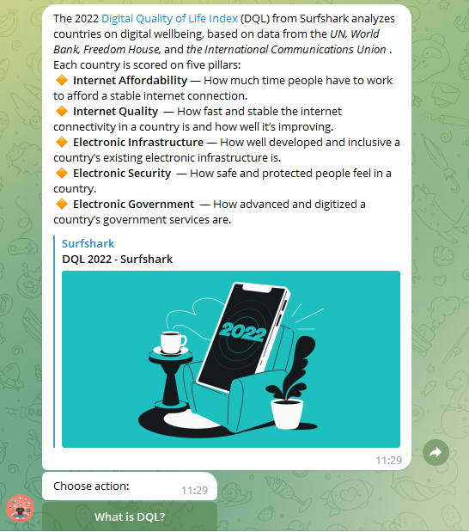
About survey
What is DQL?
Metrics:
Internet Affordability
Internet Quality
Electronic Infrastructure
Electronic Security
Electronic Government

Slide 27


Code design
Step #1
Step #2
Parse a site
Run a bot

Slide 28
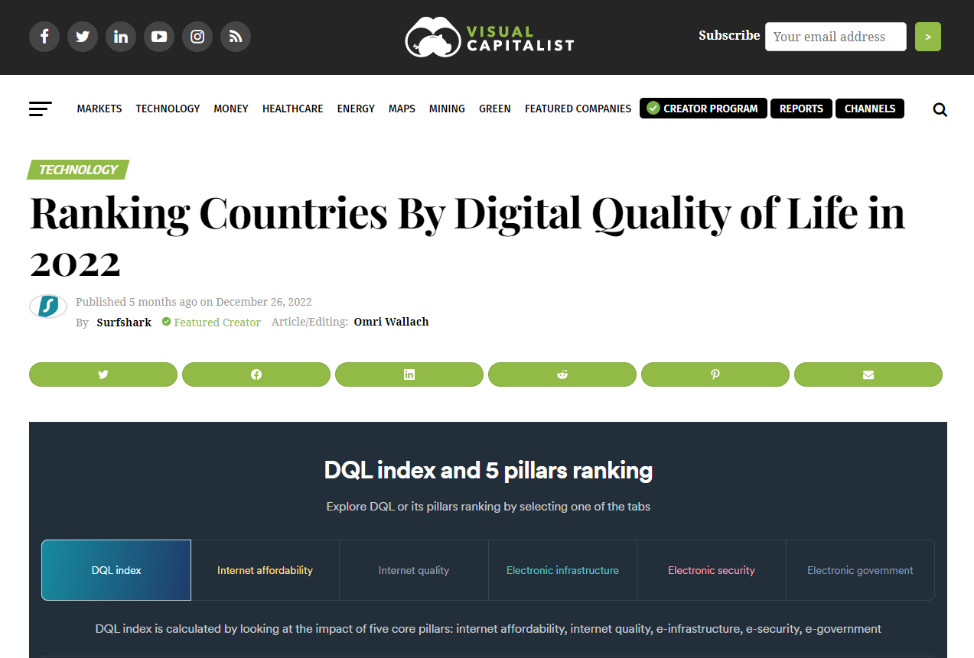

Code design
1. Parsing a site
with Beautiful Soup
Parse
URL: https://www.visualcapitalist.com/cp/ranking-countries-by-digital-quality-of-life-2022/
Output file: 'data.csv'

Slide 29



Code design
2. Running a bot
with pyTelegramBotAPI
Dispatch action
Send message
Delegate action
Bot
Controller
get_country_list()
get_total_info("by_rank")
get_total_info("by_country")
get_dql_info()
get_help_info()
get_top_five()
Get country info
User
Send response
Prepare data

Slide 30
results
Novelty – 100%
No similar bot was found
Efficiency
Efficiency = (Size of developed software)/(Resources Used)
What is the biggest success?
Finite product
User-friendly interface
Easy to add new features

Slide 31
What else can be done?
Functionality:
Provide information sorted by metrics.
Add possibility to download data in different extensions.
Implement tests.

Slide 32
THANK YOU
Time for questions…

